Slide 1
Motivation
Performance, performance, performance!
Requirements
2 areas @ 3 channels @ 1024x512 pixels @ 30 Hz = > 100 MPixels/s
Easy adaptability for 1...N areas
Using FPGA or standard analog integration
Very high resolution scanning 10kx10k pixels

Slide 2
Design decisions
Programmed in C++ under Windows (>= 7) using Microsoft Visual Studio 2012
Windows Template Library for GUI
Direct2D for drawing images and histograms
C++11 std::threads for multithreading
Windows Imaging Components for tiff handling
Boost for some nice stuff
Doxygen for semi-automatic generation of documentation

Slide 3
Labview | C++
Limited user base | Very large user base
Mostly measurement & control software | All kinds, high-performance, buisness critical applications
Data flow paradigm | Procedural, object-oriented
Quite memory hungry | Lean
Inherent massive multithreading | Full control (and responsibility) for threading
Very convenient for small programs | Overhead for small stuff
Questionable scalability | Excellent scalability
Easy&rich graphical user interface | Various UI libraries available but not easy

Slide 4
Supported hardware
All National Instruments DAQmx stuff via DAQmx C-API: 6259 & 6229 tested
All NI FPGAs via NI FPGA C API: 7962R with 5771 & 6587 tested
Feinmess stages with Galil controllers via Galil‘s C++ API
Standa stages with Standa C API
Sutter stage via Windows serial communication
In theory everything that can be controlled via a C/C++ API, NI VISA, or serial connection

Slide 5
How to get it
Code hosted at http://sourceforge.net/projects/rkscope
You need an account at sourceforge and have me add you to the project
Source-control via Git, integration into Visual Studio
~27k lines, 24% documentation, ~12k statements
Documentation at http://rkscope.sourceforge.net

Slide 6
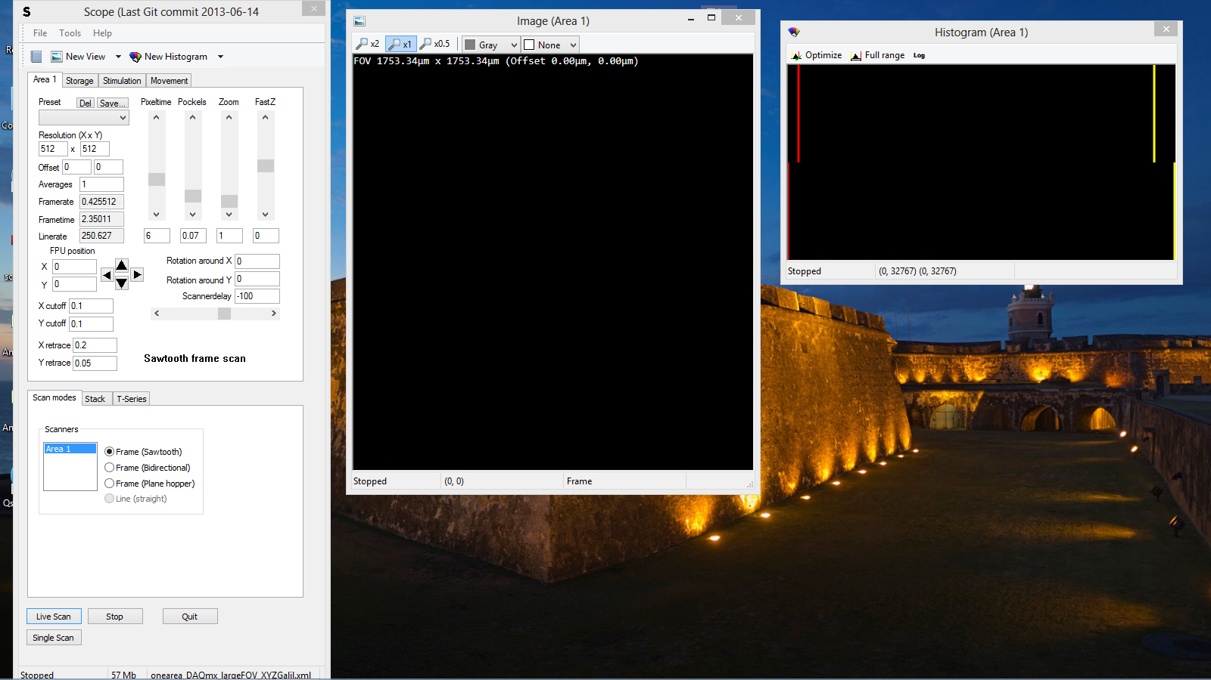
How does it look

Slide 7
How does it work
Windows user interface
CChannelFrame
Calculates channel overlay
Display images
ScopeController
Control logic
Communication w hardware
CHistogramFrame
Calculates histogram
Display histogram
CMainDlgFrame
Displays parameters
Handles user input
CLogFrame
Display log messages
Edit user notes
ScopeLogger
Handles error logging
Handles/stores user notes

Slide 8
How does it work
ScopeController
Protected:
DaqController
PipelineController
DisplayController
Send images to CChannelFrames and CHistogramFrames
Queues
Queue chunks of pixel data
Queues
Queue images
Inputs 1..N
Read pixels from hardware
Pixelmapper 1..N
Outputs 1..N
Send scanner / ETL / Pockels signals to hardware
Queues
Queue images
StorageController
ScannerVector 1..N
Calculate scanner / ETL / Pockels signals
Encoder 1..N
Encode & save to TIFF
Shutter 1..N
Send open/close to hardware
Public:
Stimulation 1..N
Send stim signal to hardware
parameters
GuiParameters

Slide 9
Configuration
The number of areas has to be defined at compile time
-> N = 2
The type of hardware-related classes has to be defined at compile time
-> Inputs = InputsDAQmx or InputsFPGA
Parameters are loaded from XML at program start and can be changed at runtime
-> GuiParameters::areas[0]::pixeltime = 5 µs
-> GuiParameters::areas[0]::daq::outputs::channels = „PXI-6259_0/ao0:3“

